Slide 1
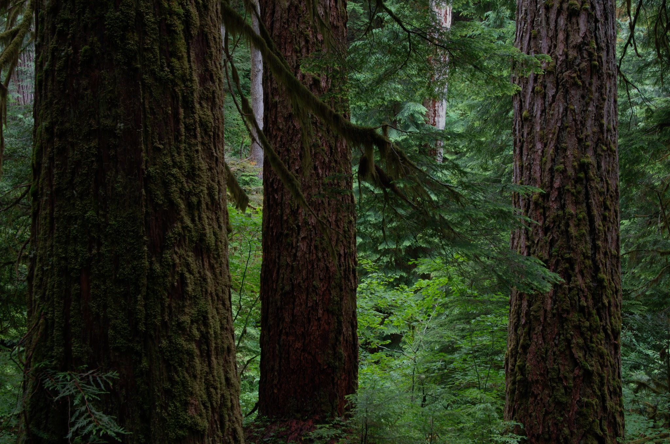
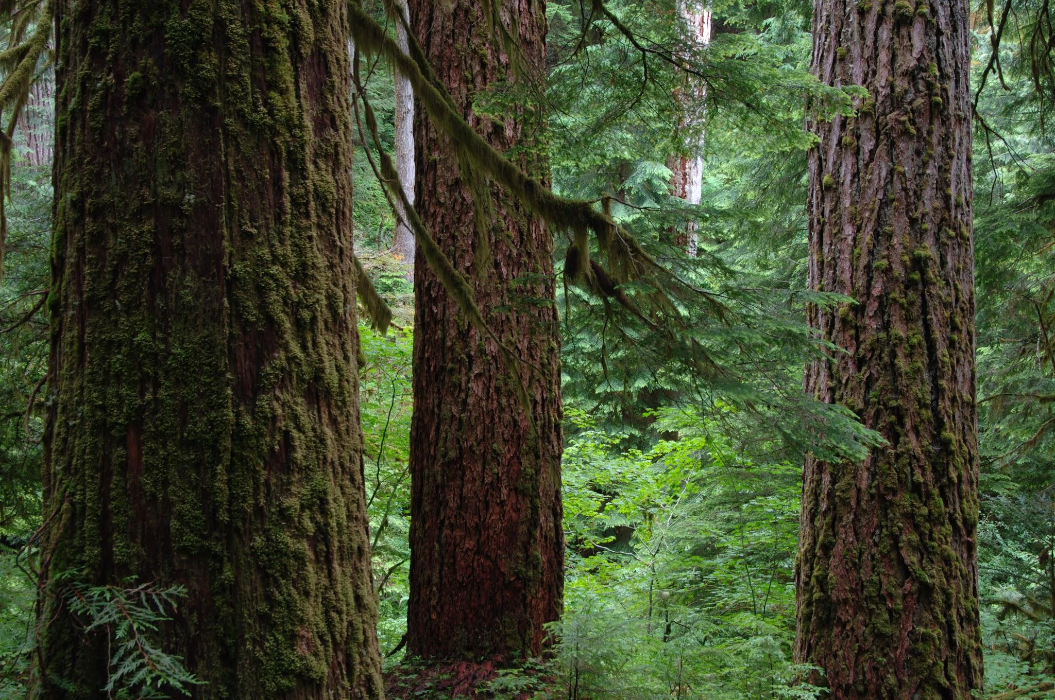
Old Trees, New Climate: How Do Douglas Fir and Western Hemloc k Respond To Heat Waves?
Gabby John | May 3, 2024 FES MS Thesis Proposal

Slide 2
Over the next ~1.5 hours hours we’ll discuss…
01
02
03
04
05
06
Introduction
Research Gap
Research Questions
What is the background and broader significance of my proposed project?
What is my proposed project contributing to science and society?
What am I specifically asking & hypothesizing?
Proposed Methodology
Expected Timeline
Concluding Remarks
What data and tools will I need for this project?
How will I ensure a proper project completion?
Sources, thanks, and invitation for questions

Slide 3
01
Introduction
What is the background and broader significance of my proposed project?

Slide 4
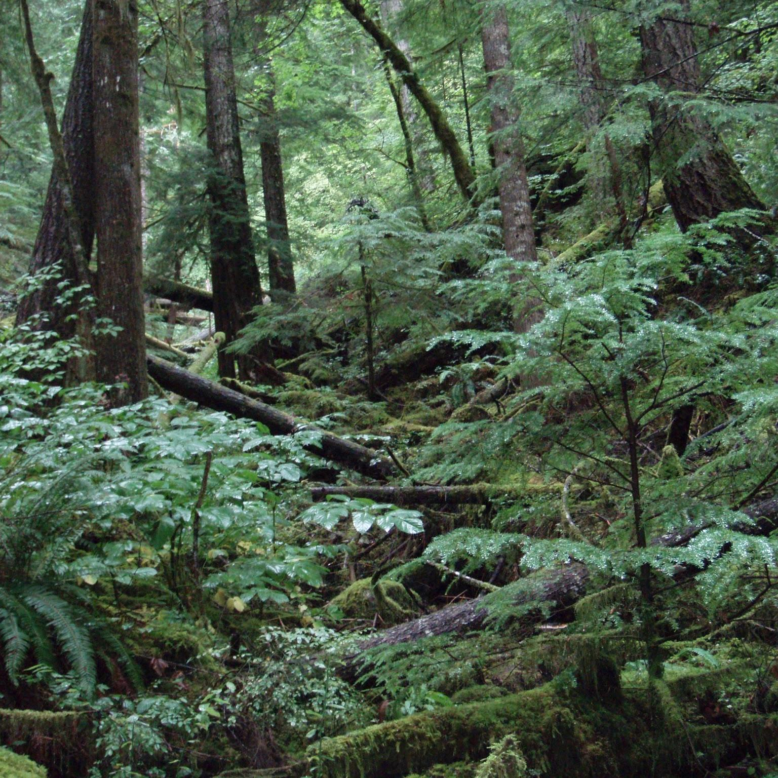
Climate is changing
MOG trees matter
We need specific study
The earth is getting hotter and drier.
Mature (80+ years) and old-growth (200+ years) trees are continuously growing and providing ecosystem services & resilience.
Estimating future MOG coverage and adaptations at the species and individual-levels first requires present knowledge.
Notes:
Mention why MOG is grouped together and the resilience to climate stress vs younger trees

Slide 5
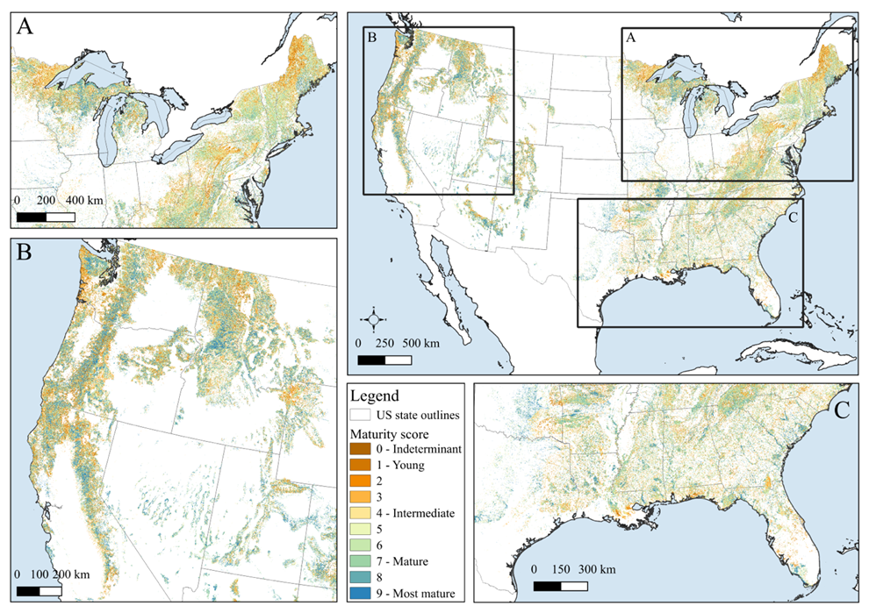
Range of forest maturity in the lower 48
36% of forest structural classes = MOG (most in the West)
DellaSala et al., 2022

Slide 6
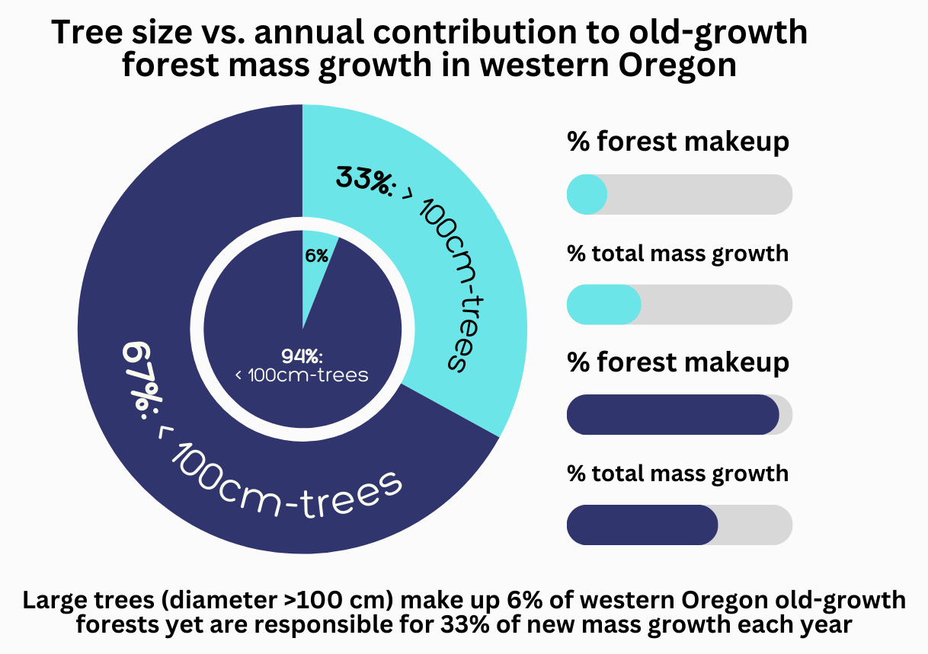
Data: Stephenson et al., 2014 Figure: Gabby John

Slide 7
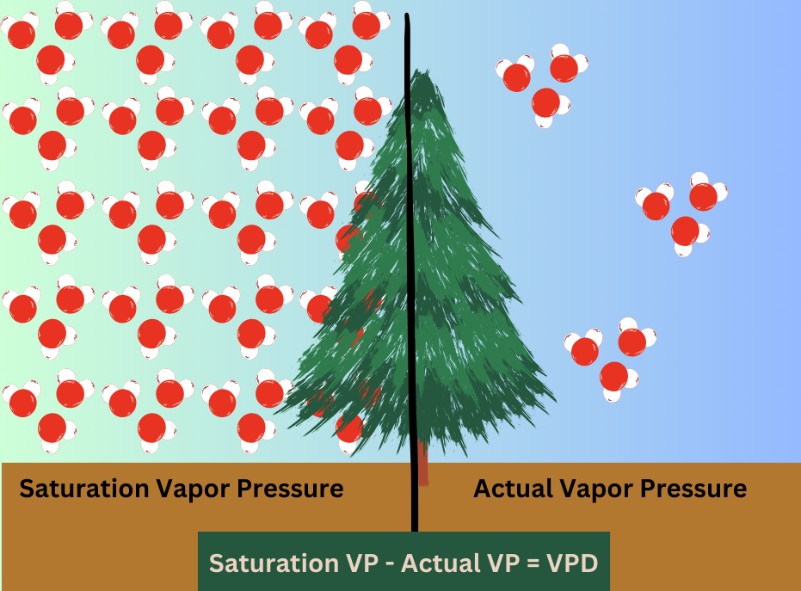
Stomatal conductance and carbon assimilation are directly related
↑ VPD → ↓ GPP
Deficits (VP and climatic water) can ↑ with temp., even if no change in precipitation (evaporative demand)

Slide 8
02
Research Gap
What is my proposed project contributing to science and society?

Slide 9
What makes my project novel?
My Project
Climate change
Mature and Old-growth
Tree physiology
Heat waves and drought
Late successional forest structure
Tree rings and other tree sensors
Learning about plants amidst high temperatures and low precipitation
Learning about X tree species of Y age with and without models
Learning about plant mechanisms and behavior

Slide 10
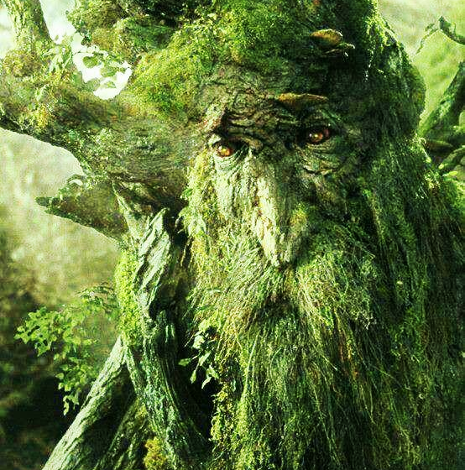
Nature’s grandparents
Stem accounts for 72-75% of a tree’s biomass
More resilient to stand disturbance than younger, smaller trees
Yet, challenging to study
Models need to be validated
Species-individual responses need to be checked

Slide 11
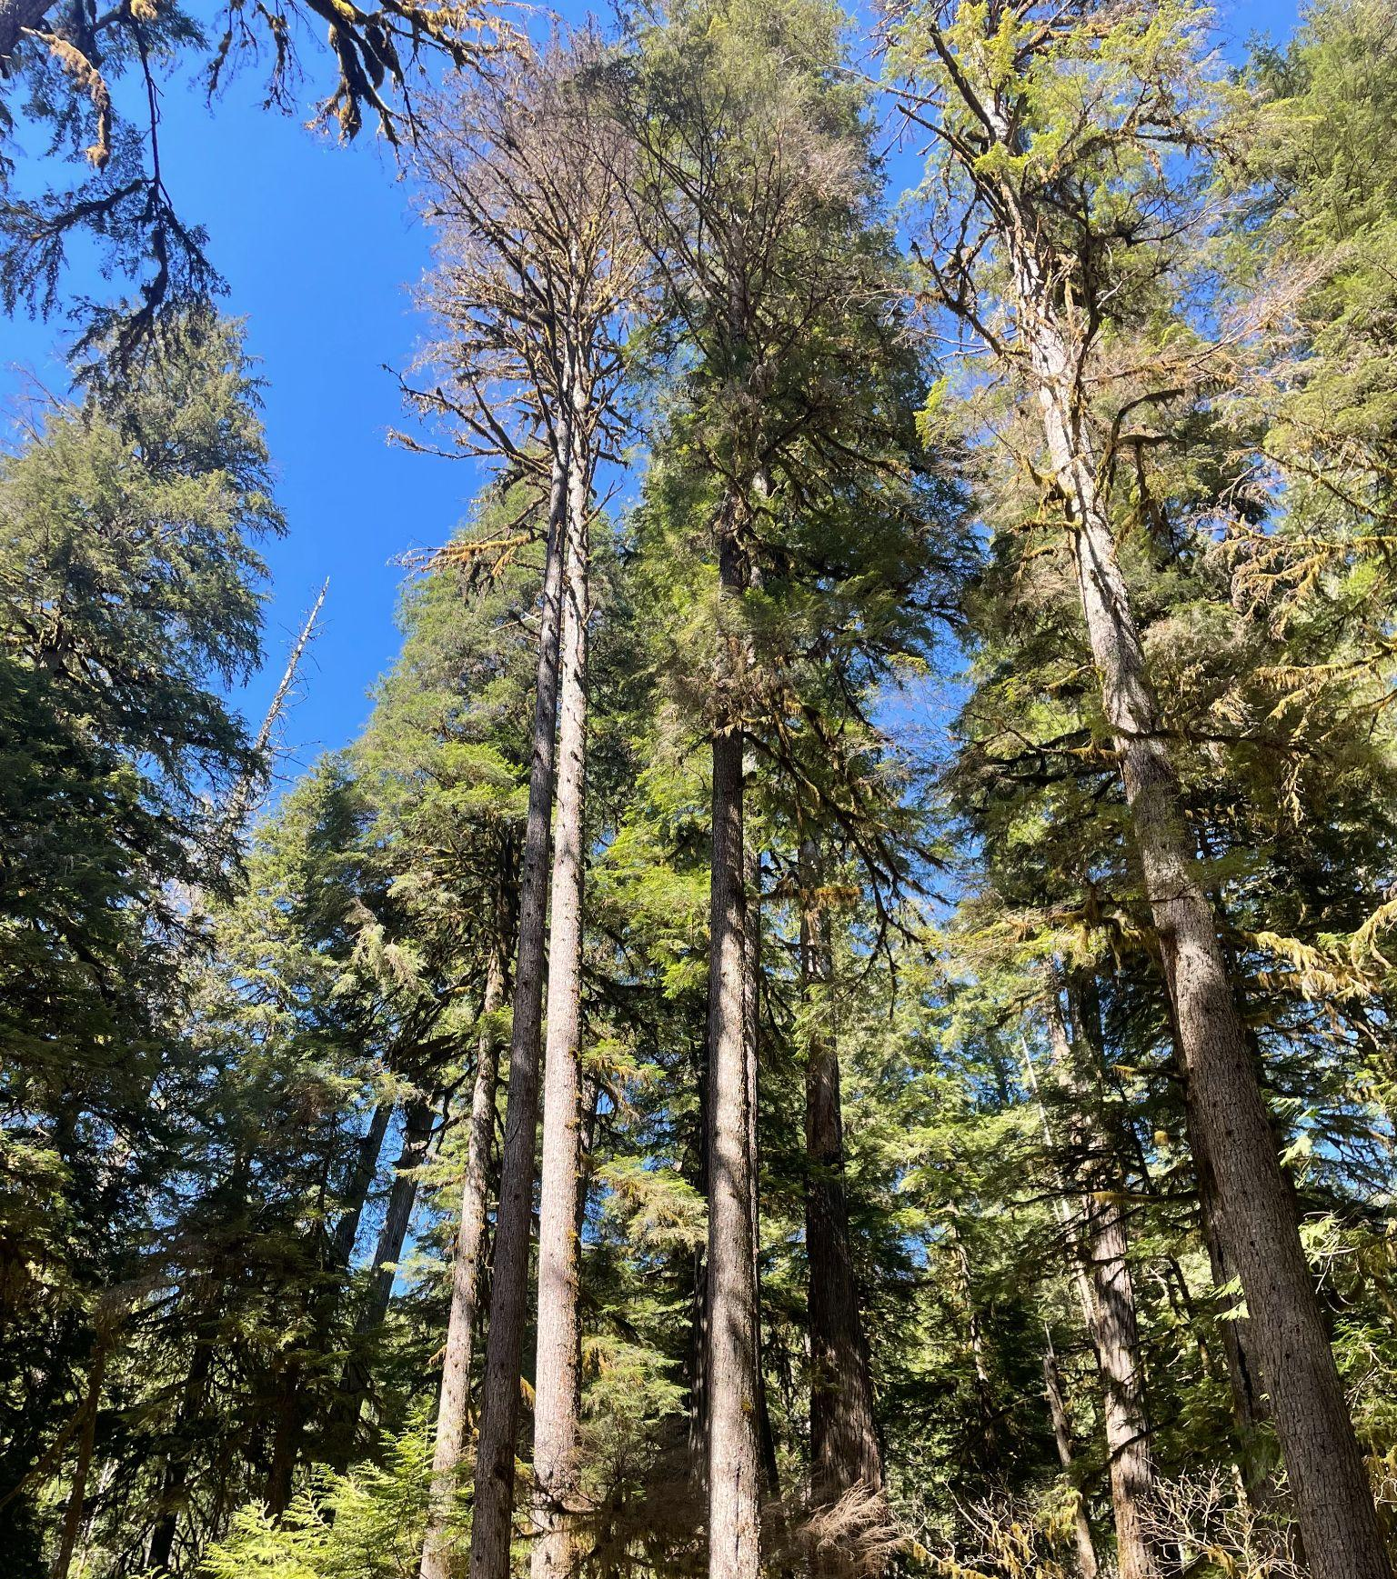
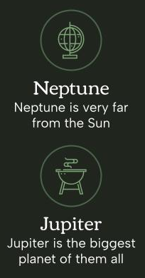
Degrees of foliar scorch
Tree vigor (based on % mortality of crown) is a significant driver of tree mortality
Andrews Discovery Trail has a gradient of foliar scorch on mature WH due to DF canopy opening
Unique opportunity to study varying degrees of heat stress (if time allows)

Slide 12
03
Research Questions
What am I specifically asking & hypothesizing in the proposed project?

Slide 13
Research Questions for Thesis Chapters
Chapter 1
Chapter 2A
Chapter 2B(?)
How does short-term growth of DF and WH change before, during, and after heat waves since 2018 at the HJ Andrews Discovery Trail?
How has long-term growth of DF and WH changed over the last few decades at the HJ Andrews forest Discovery Trail as seen in tree rings?
(If time allows) Does the degree of foliar scorch from heat waves affect long-term growth of WH at the HJ Andrews Discovery Trail?

Slide 14
Hypotheses for Question 1
On average across the site, growth of both DF and WH will slow or cease shortly after a heat wave event
The slowed/ceased growth of DF and WH following the heat wave will last throughout the growing season, possibly multiple
WH will be more severely affected by heat wave-induced growth cessation than DF will

Slide 15
Hypotheses for Question 2
In both DF and WH, total ring width but especially latewood width will be significantly smaller during heat wave years.
During years where spring precipitation was normal, heat waves will be more easily seen in the tree rings via reduced latewood width.
(For 2B): Foliar scorch from heat waves will negatively affect longer-term WH growth.

Slide 16
04
Proposed Methodology
What data, skills, tools, and knowledge will I need for this project?

Slide 17
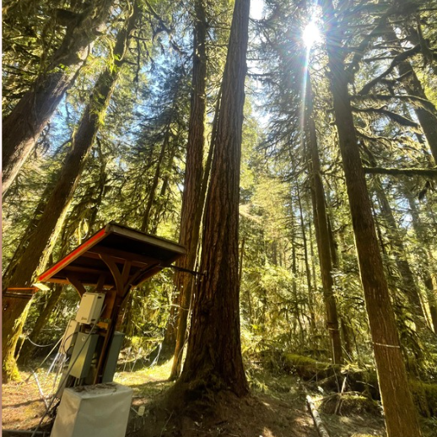
Study Site: HJ Andrews Forest
Lookout Creek Watershed
Discovery Trail
Moist valley bottom of HJA
OG forest structure;
trees 450-500 years old & 60+ meters tall
Dendrometer data will rely on within-canopy air temperature and relative humidity of nearby trees

Slide 18
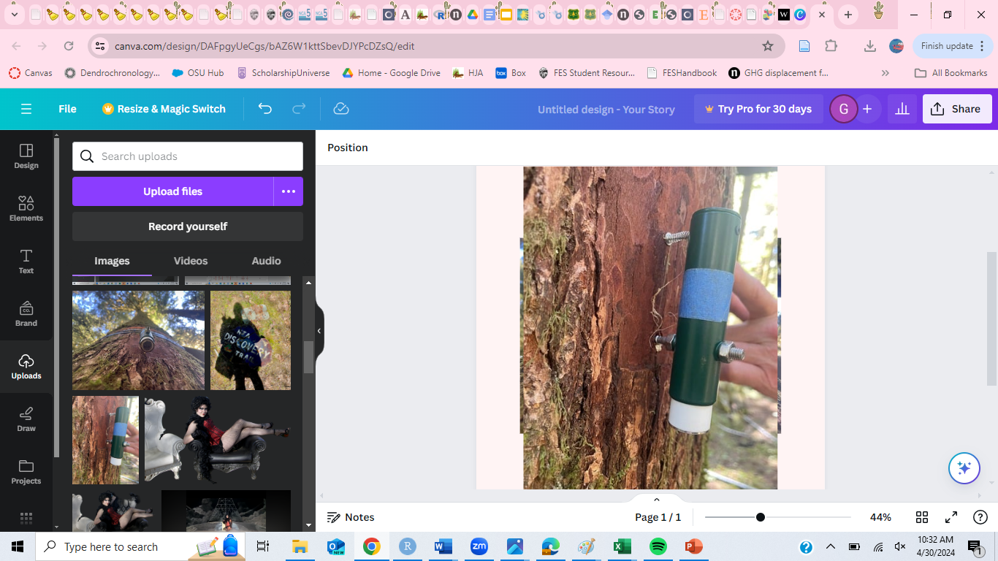
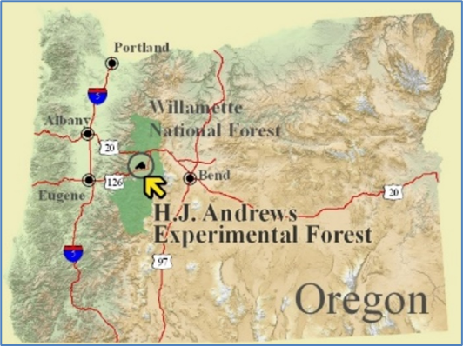
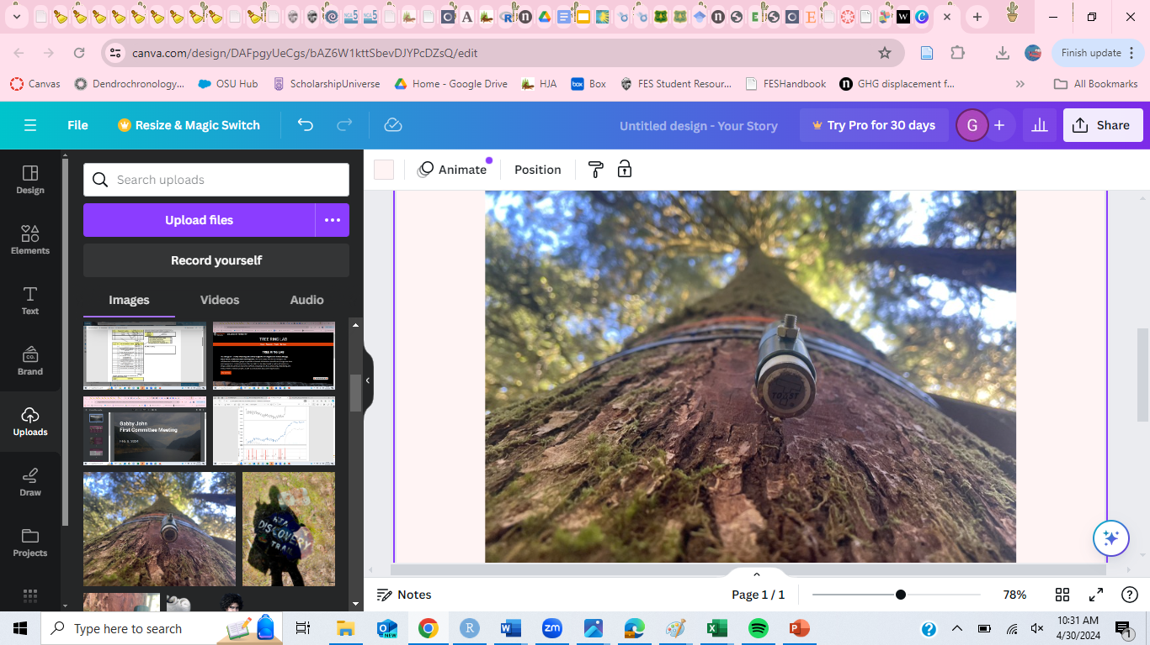
Dendrometers at HJA
Records shrinking and swelling in microns every 5 mins
TOMST & Ecomatic (and manual)
3 OG DF ( - Discovery Tree) & 1 OG WH since 2018 (IDs 309, 310, 311, 646)
2 other WH with less data (~2022)
More options nearby (RS20)

Slide 19
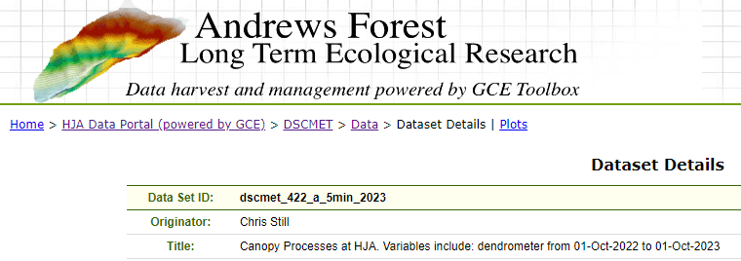
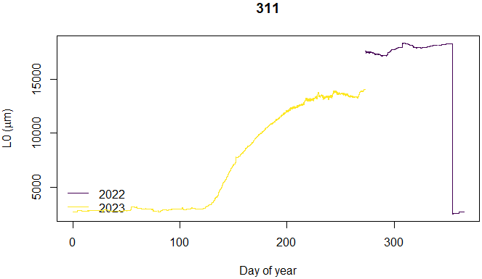
Dendrometer Analyses (Ch. 1)
R pac kage
TreeNetProc (TNP)
Level 1 TNP: time-aligning data (temp. and dendro.)
Level 2: Detecting and removing errors in data (not to be 100% trusted)
Level 3: Adjusting time frame
So we can turn this

Slide 20
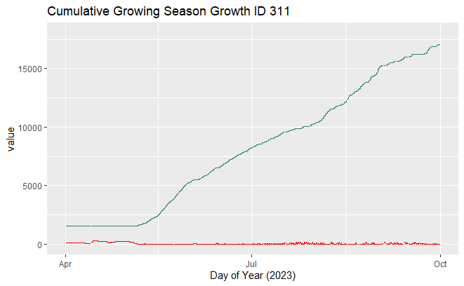
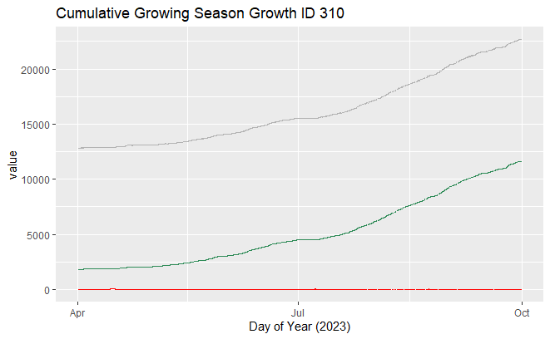
…into this!
(Air temperature data is from DSCMET 420 40 meters up into the canopy)
Venus
Mars is actually a very cold place
Venus has extremely high temperatures
Jupiter
Gray = dendrometer readings
Green = cumulative growth since Oct. 2022
Red = TWD
Jupiter is the biggest planet of them all

Slide 21
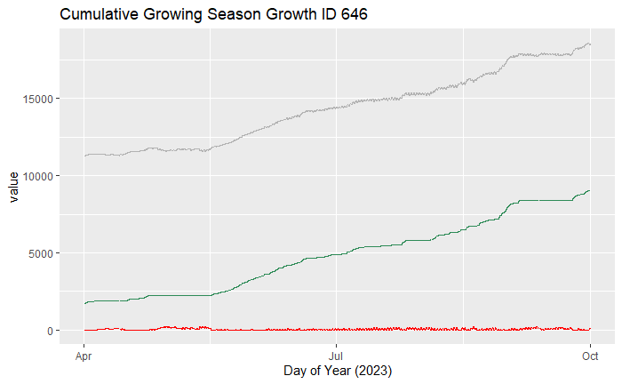
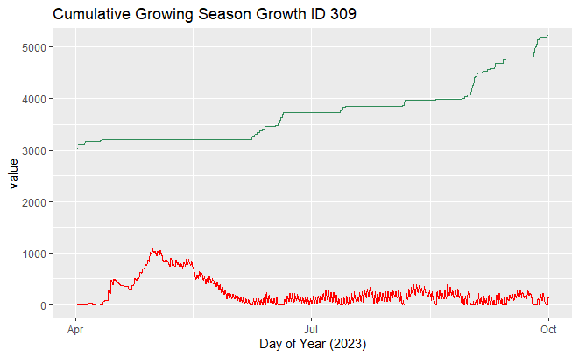
Analyzing Dendrometers: Progress (cont’d)
Venus
Venus has extremely high temperatures
Jupiter
Gray = dendrometer readings
Green = cumulative growth since Oct. 2022
Red = TWD
Jupiter is the biggest planet of them all

Slide 22
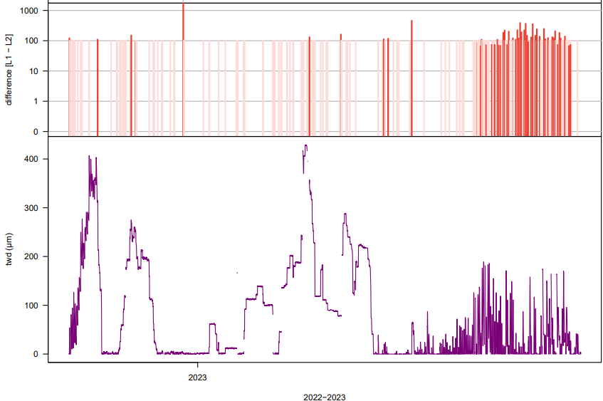
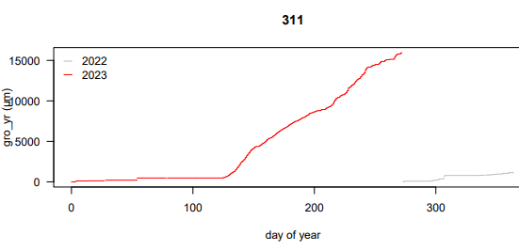
A closer look (311)
After TNP L2, a PDF with L1 & L2 results, statistics on missing & interpolated data, summary statistics, and these are made:
L1-L2; TWD; Gro_yr
TNP calculates TWD from growth (negative relationship) without temperature
Jupiter is the biggest planet of them all

Slide 23
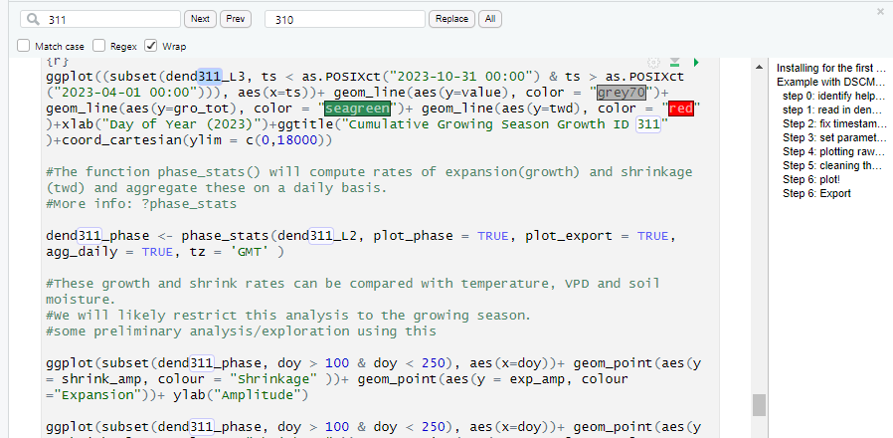
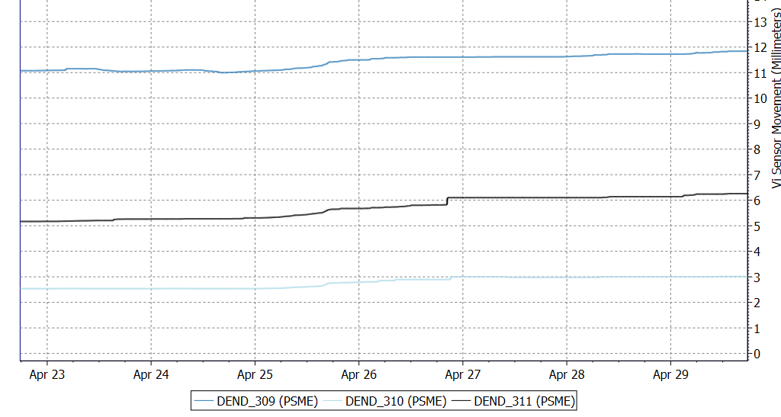
Using R outside TNP?
TNP provides lots of information - not perfect
R has other pac kages to explore (e.g., “heatwaveR”)
If there is time, other functional relationships can be analyzed in R, too (e.g., TWD versus c(VPD, air temp, soil water, relative humidity); cumulative seasonal TWD versus cumulative season growth

Slide 24
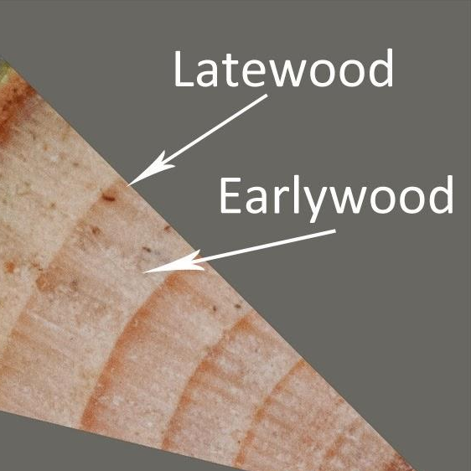
Tree Cores (Ch. 2)
40-90 cores from each site (2-3 cores from 10-15 trees of DF and WH); more WH for 2B
Varying collection techniques
RS 20: mainly secondary DF (100-120 years old)
Nearby weather station to provide reference data
Collection → drying → mounting → sanding → counting

Slide 25
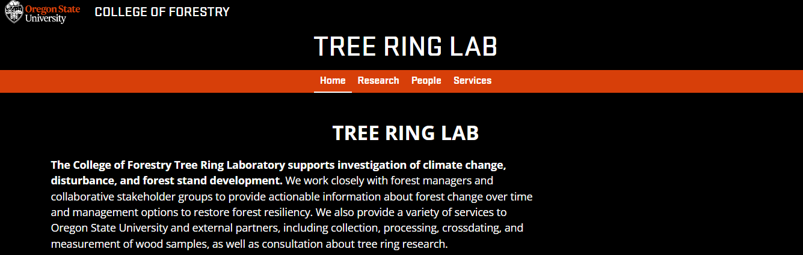
Help with benchwork is expected from OSU tree ring lab (e.g., Amanda Brac kett)
Whole tree ring width but focus on latewood
Methods to eliminate “geometric bias” of ring width vs. tree age

Slide 26
05
Expected Timeline
How will I ensure a proper project completion?

Slide 27
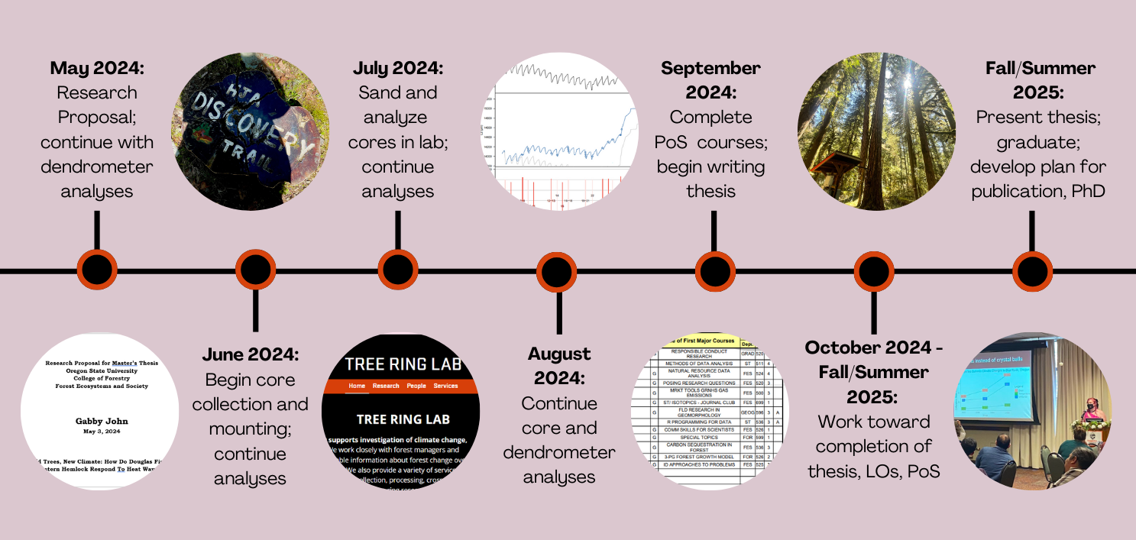
—Somone Famous

Slide 28
Concurrent expectations for completion
01
Field work
Curricula
06
Summer work collecting tree cores
06
Fulfilling my PoS and LOs
01
02
Presenting
Lab work
05
05
Presenting my work to fulfill LOs
Analyzing collected tree cores
02
04
03
Writing
03
Computer work
04
Writing my thesis
Analyzing core and dendrometer data

Slide 29
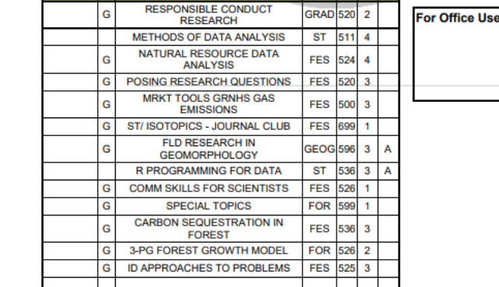
Revisiting the Program of Study
Core collection: Summer 2024
Core analysis: Summer - Fall 2024
FES 524: Winter 2025 - will use real data
Wrap up: Summer - Fall 2025

Slide 30
06
Concluding Remarks
Thanks and invitation for questions

Slide 31

06
THANK YOU!
This presentation came from a template by SlidesGo with icons coming from Flaticon and some infographics coming from Freepik.
I welcome additional questions & comments!

